Slide 1
Voluntary Benefits.
Enrollment Solutions.
Protecting What’s Important
MMX – EXPERIENCE THE VALUE PROPOSITION
Michael Richerson

Slide 2
MMX & VBES Overview and Level Set Value Prop & Selling Discussion Q&A and Close

Slide 3
MMX and VBES – Some Key Points
Prospects: Every 1,000 Life Client/Prospect is a VBES Prospect
An Important Subset of those (10% - 20%) are Also Great MMX Prospects
Every MMX Solution Includes VBES
But currently, we have a few wrinkles
Self Service Enrollment, Custom Communications
& Enrollment Café are the Main VBES Options
Still working on using VBES Call Center and “1 to 1”
Alight Issues Involved in working this out
Reminder: U2X is an Enrollment Only Platform
MMX is a true year-round ben admin platform solution
Some signs the client needs a new platform, they may struggle with:
- Data Issues (payroll deductions, carrier eligibility feeds)
- Life Event Processing, COBRA or FSA/H.S.A. Integration, etc.
- Overall Carrier Management Issues
- ACA Reporting, Carrier Premium Billing, or other “reporting” related issues
- Employee Service Issues (engagement, answering questions, etc.)
MMX – VBES Now in Every Deal!

Slide 4
So, What Makes a Prospect a Good “Fit” for MMX
Average Complexity of Plan Designs and Carrier Options
H&B Broker of Record (No BOR, No MMX!)
Truly Wants a Year Round, Full Ben Admin System
Limited Union, Retirees or Grandfathered Groups
Struggling with Current Solution, Costs or Employee Service
3 Year Contract Term
Notes:
Average 2017 Deal Size, New Logo: $312,000, Existing: $167,000 & 1,800 EE

Slide 5
Revenue From MMX Deals is Significant!
# of Employees enrolled | ~ Total Sales Revenue (HB + Admin Only) | Total Sales Revenue Adding VBES
500 | $ 150,000 - $175,000 | $180,000 - $207,500
1,000 | $ 250,000 - $275,000 | $310,000 - $340,000
2,000 | $ 325,000 - $350,000 | $445,000 - $480,000
3,000 | $ 400,000 - $450,000 | $580,000 - $645,000
4,000 | $ 500,000 - $600,000 | $740,000 - $860,000
* Recurring Revenue numbers are focused on New Logo Clients. Average VB Revenue was set at $60 to $65 per Benefit Eligible Employee. Also, Average New Logo MMX Sale in 2017 was $330K; and 2,000 Employees
Notes:
I like to focus on the size of the deals….all revenue is 100% ARS, 100% H&B, it all counts towards your revenue and office goals (which is not always the case with other Aon H&B Ben Admin solutions).
Mid Market prospects NEED this solution; and the Revenue is very Significant.

Slide 6
MMX & VBES Our Growth Story Solution Overview

Slide 7
Growing Supplemental Health Solutions (VB) is Key MMX + VBES = Win for Aon!
MMX will now include a VBES Option in every deal!
MMX News
VBES News
Added 19 New Clients in 2017
Alight “noise” has settled down (market understands the change; subcontractor to Aon, etc.)
Aon/Alight is still # 1 H&B ben admin player (with Alight as delivery partner)
Decades of Benefits Expertise
MMX Sales Leads: Steve Carleton (West and Central) Andrew Mazuro (East), Michael Richerson (SW and South)
Added 175+ Clients in 2017
Helps employees enroll in Core Benefits and VB
Improved EE Experience drives client satisfaction!
Increased Participation in Voluntary drives revenue!
Sold stand-alone (U2X platform) or in tandem with MMX (CBA/Alight platform)
Some CBA/Alight operational details still being finalized

Slide 8
MMX: Continued Growth in 2017!
MMX Total Contract Value Impact in 2017 ~ $12M
Average Deal Size
$330K
(New Logo)
60% Referenceable Clients*
217% Growth in Weighted Pipeline YoY
49 MMX Clients and Growing!
Projected 349% Growth In Booked Revenue YoY
Notes:
Average 2017 Deal Size, New Logo: $330,000, Existing: $125,000 & 1,900 EE
60% of MMX Clients (on platform 1+ years) are Referenceable (and the numbers are growing as newer clients get a year under their belt)

Slide 9
Overall, Aon Exchange Adoption Is Consistently Growing: Data includes both LM and MMX Data (MMX is fastest growing segment)
Employers
2018
92
2017
75
2016
55
2015
33
2014
18
Industries
Carriers
NOW
23
NOW
>30
2017
22
2017
>30
2016
22
2016
>30
2015
13
2015
30
2014
7
2014
20
Notes:
Source: Actuarial
Last Updated: January 2017
Next Update: January 2018

Slide 10

Middle Market Exchange: Poised for Continued Growth!
MMX Data Only: Employers
2018
70-80 (Projected)
2017
49
2016
30
2015
15
MMX Medical Covered Lives
2018
200,000 – 225,000 Projected
2017
138,000
2016
81,000
?
MMX Pipeline Growth
2018
18
2017
2016
Notes:
-200,000 – 225,000 covered lives = avg. number of covered lives X 25 new wins

Slide 11
MMX Solution Overview

Slide 12
MMX: A Comprehensive Solution from the # 1 Ranked Provider
Financial Flexibility
Ranked #1 H&B provider in U.S. by Nelson Hall
Plan Choice
Carrier Agnostic
Single or Multiple Plan Offerings
Largest global footprint of any benefits broker in the world
Administration supporting over 10.5M Customers
Defined Contribution or Defined Benefit
Full-Replacement CDHP
#1 Health and Benefits actuarial practice
Full Suite of Complementary Solutions
Fully Insured or Self Insured
Exchange Metallic Designs
Aon Middle Market Experience
Health & Benefits Consulting - Aon
Administration and Carrier Management – Aon/Alight
Largest US Data Management/Data Security Teams
Largest US Benefits Service Center Teams (Winston-Salem & Orlando)
Notes:
NOTE: we will need to talk about the Blackstone/NewCo issues here. Bottom line, if they are looking at Towers, then that combo is Towers plus Lizaon (not a great platform, Towers has only been working with it for 12-18 months, etc.)…..if they are looking at Mercer, that combo is Mercer plus Benefitfocus (and Benefitfocus is really struggling with quality issues….and they have been working together for 24-36 months). If it’s Aon, it’s best in class Aon consulting plus best in class Aon ben admin platform, decades of shared experience and expertise serving the same clients……the admin business will now be our key strategic partner and subcontractor (with 100% of current revenue coming from Aon); instead of a division of Aon. So yes, it’s a change, but our overall “model” is still the best, most high quality model in the industry.
At Aon we are experienced in all areas of health. we cover the full spectrum of services from advisor/sponsorship to administration to specific delivery employee services.
This slide shows the full scope of our services from health and benefits consulting to administration to exchanges. Can meet you where ever you are in your health benefits strategy. In addition, all of our services are found on the principles of a trusted partnership, with data driven insights that feature not only depth and scale but are also integration with our signature comprehensive support.
Health & Benefits Consulting
Over 900 consultants serving over 5,000 employers
Industry experts on Health Transformation, Absence, Pharmacy, Life/Disability, Elective and Executive Benefits, Compliance
Actuarial Consulting
#1 Health and Benefits actuarial practice domestically and globally
Communications
100+ awards for quality and innovation
600+ clients
Administration
Ranked #1 HW provider in US by Nelson Hall
Scalable services
Point Solutions
Full suite of complementary solutions including health reimbursement accounts transit, adoption, Absence Management, Advocacy, Dependent Verification
Active Health Exchange
Launched first private health exchange in 2012
Serve 33 clients with over 850,000 employees & dependents
All except one relatively small client that was acquired have renewed each year
Average trend over 2 years is 2.6% - - delivering on 2 of the original business objectives to create a sustainable solution and reduce the year over year rate of growth
Retiree Health Exchange
Retiree exchange serving 53 clients and over 350,000 retirees
Health coverage resources serving 35 clients and over 1.5 million individuals

Slide 13
Aon’s MMX: Full Spectrum of Flexible Solutions
Financial Flexibility
Plan Choice Flexibility
Fully-Insured
or
Self-Insured
Defined Contribution or Benefit
Carrier Agnostic
Single or Multi-Plan Offerings
Full-Replacement CDHP
Metallic Designs
Aon Middle Market Exchange
Health & Benefits Consulting
H&W Administration, Enrollment, and Compliance
Call Center & Advocacy
Customer
Experience

Slide 14
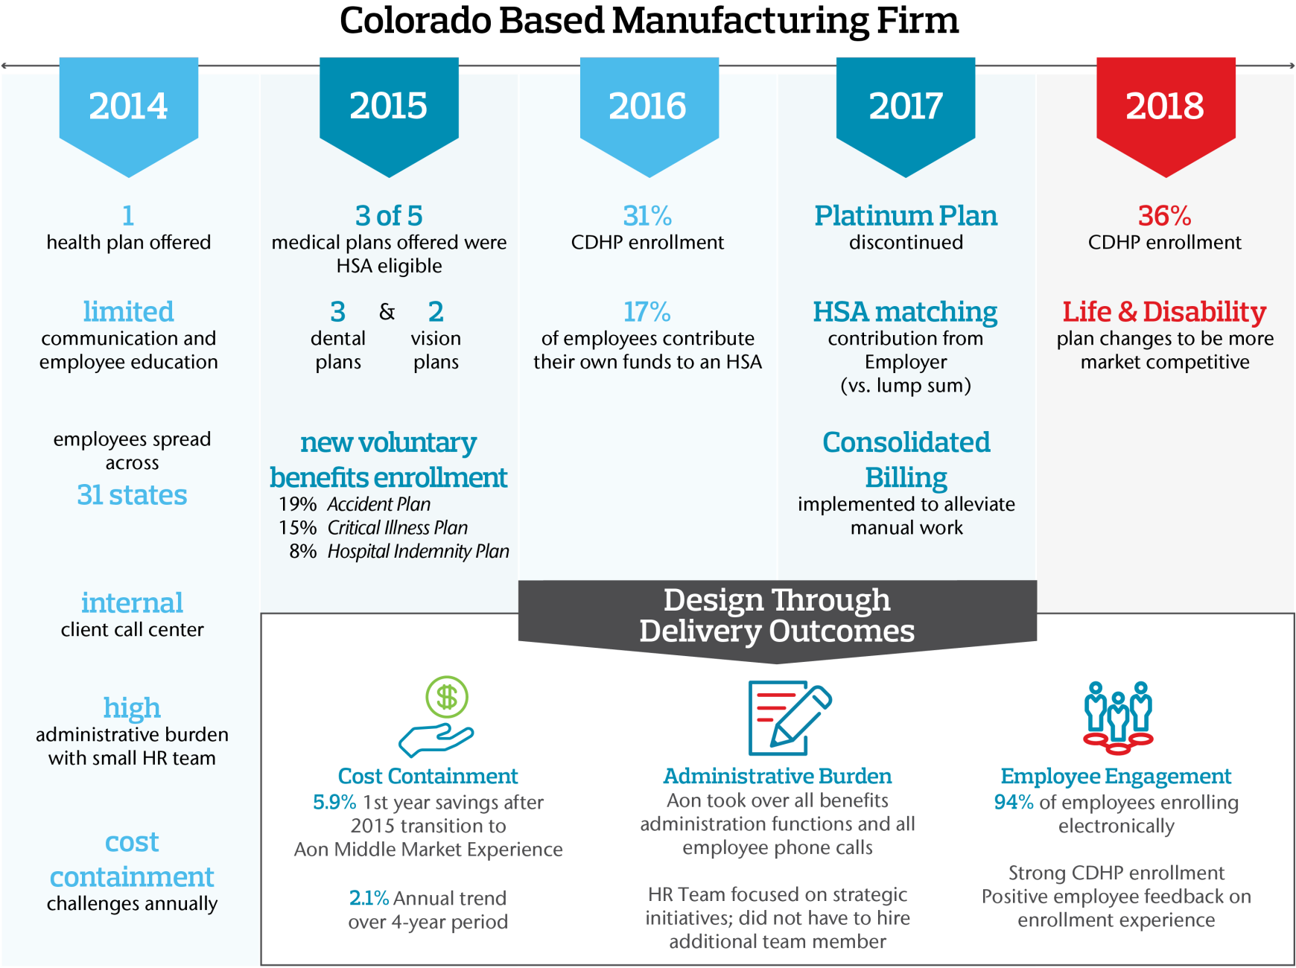
Client Results Example: Value of Design Through Delivery

Slide 15
H&W Benefits Administration Tasks – The Full Picture, Lots to Do!
Event Processing
Administrative Tasks
Communication
Employee Support
Vendor Management
Reporting
Processing
Interface Processing
Maintenance & Compliance
Eligibility Determination
Plan Design
& Rate Negotiations
Reconcile Undeliverable Emails
Provide Decision Support Tools
Carrier Enrollments
Produce SAS70 Type II Reports
Evidence of Insurability (EOI) Approvals/Denials
Schedule and run Payroll Deduction File
Disaster Recovery & Contingency Planning
Employee Status Change Events
Plan Fiduciary
Responsibility
Produce Eligibility Worksheets
Participant Call Center
Make Premium Payments to Carriers
Produce Scheduled Reports
Verify Disabled Dependent Status
Calculate Employee Cost of Coverage
Maintain Section 125/HIPAA Compliance
Family Status Change Events
Correct HR
Data Errors
Produce Election Confirmations
Case Management
Process Emergency Enrollments
Maintain Data for Ad Hoc Reporting
Verify Dependent / Student Status
Calculate Employer Cost of Coverage
Provide Administrator Portal
Annual Enrollment Processing
Benefits Billing for Employees on Leave without Pay
Notify Employees When Elections Change
Non-English Speaking Support
Carrier Data Reconciliation
Run Desired Ad Hoc Reports
Process QMSCO Dependents
Calculate ASO Fees
Run Scheduled Processes
Time Passing Events
Project Manage Annual Enrollment
Notify Employees of Opportunities to Enroll
Transfer to other Vendors or Carriers
Produce Carrier Invoices
Benefit Premium Reporting
Process Domestic Partner Affidavits
Calculate Retroactive Deductions
Monitor Scheduled Processes for Completion
Administrative Events
Train Administrative Users
Produce & Mail Enrollment Materials & Guides
Provide Contacts Information
Single Sign-on Integration with Third Parties
Medicare Part D Reporting
Drop Overage Dependents from Coverage
Calculate Imputed Income for Life Insurance
Maintain System Components
Identification of COBRA / HIPAA Events
Collect Beneficiary Information
Design & Produce Communications Campaign
Web Chat and Email
Annual Enrollment Migration Reporting
Calculate & Maintain Eligibility
Calculate
Imputed Income for Domestic Partners
Update System Configuration as Required
Provide Plan Materials to Employees
Maintain Election & Dependent Data
COBRA / HIPAA Administration
Maintain Historical Confirmations
Provide Plan Materials to Employees
Annual or Ongoing Dependent Audit
Schedule & Run Carrier Eligibility
Deploy System Upgrades
Direct Billing Administration
Core and Clinical Advocacy Services
Dependent Audit Result Processing
Manage Interface Errors
Health Care Reform
Collect PCP Data
Ad-hoc Employee Notifications
Provide Plan Materials to Employees
Calculate Medicare Eligibility
Claims and Appeals Management
Process Returned Mail
Mobile-enabled web site
Qualify Court Orders
Spending / Savings Account Administration
Finalize / Default Past Due Events
Finalizing Non-Self Service Events
Form 5500 Preparation

Slide 16
H&W Benefits Admin Tasks – Typical Stand-Alone Ben Admin Providers
Event Processing
Administrative Tasks
Communication
Employee Support
Vendor Management
Reporting
Processing
Interface Processing
Maintenance & Compliance
Eligibility Determination
Plan Design
& Rate Negotiations
Reconcile Undeliverable Emails
Provide Decision Support Tools
Carrier Enrollments
Produce SAS70 Type II Reports
Evidence of Insurability (EOI) Approvals/Denials
Schedule and run Payroll Deduction File
Disaster Recovery & Contingency Planning
Employee Status Change Events
Plan Fiduciary
Responsibility
Produce Eligibility Worksheets
Participant Call Center
Make Premium Payments to Carriers
Produce Scheduled Reports
Verify Disabled Dependent Status
Calculate Employee Cost of Coverage
Maintain Section 125/HIPAA Compliance
Family Status Change Events
Correct HR
Data Errors
Produce (online) Election Confirmations
Case Management
Process Emergency Enrollments
Maintain Data for Ad Hoc Reporting
Verify Dependent / Student Status
Calculate Employer Cost of Coverage
Provide Administrator Portal
Annual Enrollment Processing
Benefits Billing for Employees on Leave without Pay
Notify Employees When Elections Change
Non-English Speaking Support
Carrier Data Reconciliation
Run Desired Ad Hoc Reports
Process QMSCO Dependents
Calculate ASO Fees
Run Scheduled Processes
Time Passing Events
Project Manage Annual Enrollment
Notify Employees of Opportunities to Enroll
Transfer to other Vendors or Carriers
Produce Carrier Invoices
Benefit Premium Reporting
Process Domestic Partner Affidavits
Calculate Retroactive Deductions
Monitor Scheduled Processes for Completion
Administrative Events
Train Administrative Users
Produce & Mail Enrollment Materials & Guides
Provide Contacts Information
Single Sign-on Integration with Third Parties
Medicare Part D Reporting
Drop Overage Dependents from Coverage
Calculate Imputed Income for Life Insurance
Maintain System Components
Identification of COBRA / HIPAA Events
Collect Beneficiary Information
Design & Produce Communications Campaign
Web Chat and Email
Annual Enrollment Migration Reporting
Calculate & Maintain Eligibility
Calculate
Imputed Income for Domestic Partners
Update System Configuration as Required
Provide Plan Materials to Employees
Maintain Election & Dependent Data
COBRA / HIPAA Administration
Maintain Historical Confirmations
Provide Plan Materials to Employees
Annual or Ongoing Dependent Audit
Schedule & Run Carrier Eligibility
Deploy System Upgrades
Legend
Direct Billing Administration
Core and Clinical Advocacy Services
Dependent Audit Result Processing
Manage Interface Errors
Health Care Reform
Collect PCP Data
Ad-hoc Employee Notifications
Provide Plan Materials to Employees
Client responsibility
Calculate Medicare Eligibility
Claims and Appeals Management
Process Returned Mail
Mobile-enabled web site
Optional at additional cost
Qualify Court Orders
Spending / Savings Account Administration
Typical scope of services
Finalize / Default Past Due Events
Finalizing Non-Self Service Events
Form 5500 Preparation
Partially facilitated by admin
Actual services included will vary by vendor

Slide 17
H&W Ben Admin – Aon: Full Service to Take “Work Off Your Plate”
Event Processing
Administrative Tasks
Communication
Employee Support
Vendor Management
Reporting
Processing
Interface Processing
Maintenance & Compliance
Eligibility Determination
Plan Design
& Rate Negotiations
Reconcile Undeliverable Emails
Provide Decision Support Tools
Carrier Enrollments
Produce SAS70 Type II Reports
Evidence of Insurability (EOI) Approvals/Denials
Schedule and Run Payroll Deduction File
Disaster Recovery & Contingency Planning
Employee Status Change Events
Plan Fiduciary
Responsibility
Produce Eligibility Worksheets
Participant Call Center
Make Premium Payments to Carriers
Produce Scheduled Reports
Verify Disabled Dependent Status
Calculate Employee Cost of Coverage
Maintain Section 125/HIPAA Compliance
Family Status Change Events
Correct HR
Data Errors
Produce Election Confirmations
Case Management
Process Emergency Enrollments
Maintain Data for Ad Hoc Reporting
Verify Dependent / Student Status
Calculate Employer Cost of Coverage
Provide Administrator Portal
Annual Enrollment Processing
Benefits Billing for Employees on Leave without Pay
Notify Employees When Elections Change
(electronic)
Non-English Speaking Support
Carrier Data Reconciliation
Run Desired Ad Hoc Reports via Self-Service Reporting Suite
Process QMSCO Dependents
Calculate ASO Fees
Run Scheduled Processes
Time Passing Events
Project Manage Annual Enrollment
Design & Produce electronic & print Communications Campaign
Transfer to other Vendors or Carriers
Produce Carrier Invoices
Benefit Premium Reporting
Process Domestic Partner Affidavits
Calculate Retroactive Deductions
Monitor Scheduled Processes for Completion
Administrative Events
Train Administrative Users
Produce & Mail Enrollment Materials & Guides
Provide Contacts Information
Single Sign-on Integration with Third Parties
Medicare Part D Reporting
Drop Overage Dependents from Coverage
Calculate Imputed Income for Life Insurance
Maintain System Components
Identification of COBRA / HIPAA Events
Collect Beneficiary Information
Notify Employees of Opportunities to Enroll
(electronic & print)
Web Chat and Email
Annual Enrollment Migration Reporting
Calculate & Maintain Eligibility
Calculate
Imputed Income for Domestic Partners
Update System Configuration as Required
Provide Plan Materials to Employees
Maintain Election & Dependent Data
COBRA Vendor Integration & Coordination
Maintain Historical Confirmations
Provide Plan Materials to Employees
(electronic & print)
Annual or Ongoing Dependent Audit
Schedule & Run Carrier Eligibility
Deploy System Upgrades
Collect PCP Data
Direct Billing Vendor Integration & Coordination
Ad-hoc Employee Notifications
Core and Clinical Advocacy Services
Dependent Audit Result Processing
Manage Interface Errors
Health Care Reform
Calculate Medicare Eligibility
Claims and Appeals Management
Process Returned Mail
Mobile-enabled web site
Qualify Court Orders
Spending / Savings Account Administration
Finalize / Default Past Due Events
Finalizing Non-Self Service Events
Tasks that remain Client’s responsibilities
Optional Services that can be performed by Aon
Form 5500 Preparation
Standard tasks that can be performed by Aon Administration and Consulting Teams – based on Scope of Services
Services provided and/or enhanced by VBES

Slide 18
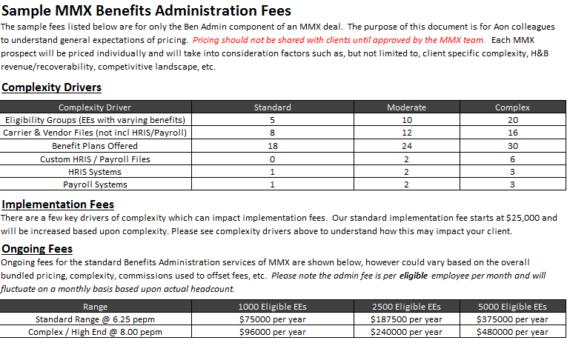
MMX Sample Pricing & Complexity: “Gross to Net” Fee Orientation Drives Lower Fees (Carrier Credits and Partial VB Offsets)

Slide 19
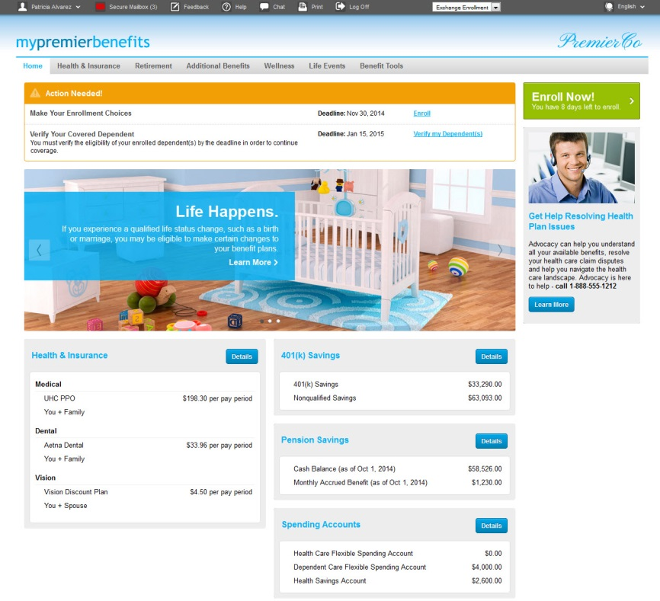
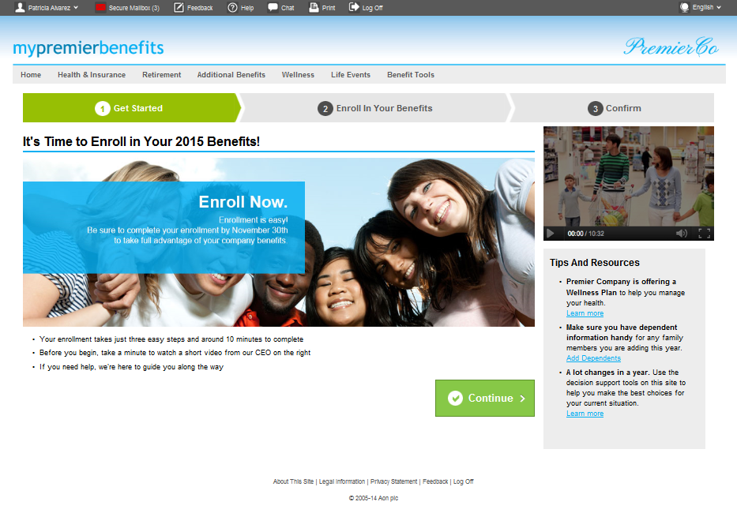

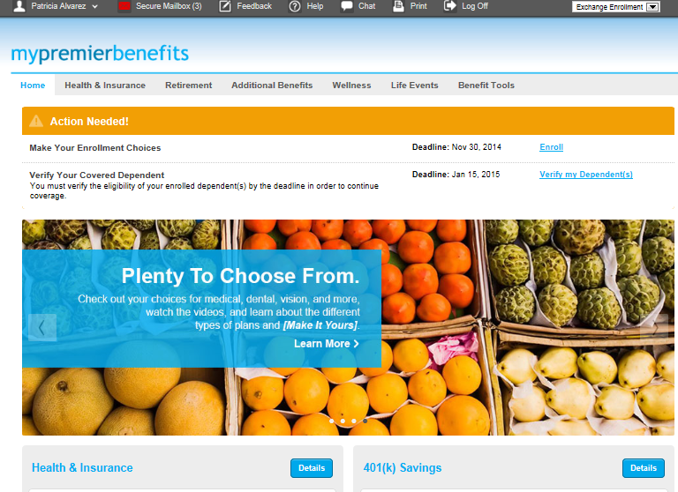
MMX Technology Platform: Flexible, Reliable, Year Round System See iPad Demo!

Slide 20
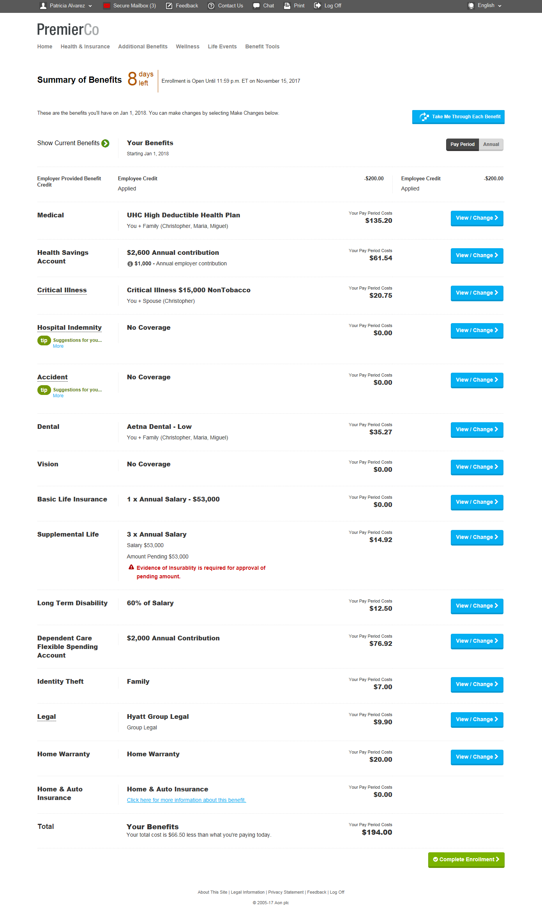
Summary of Benefits Screen
On the main enrollment screen, tier 1 elective benefits are grouped with the Medical/HSA plan. Other elective benefits are typically placed towards the end of the enrollment sequence.
In an Active enrollment on MMX, every benefit requires the employee to elect or decline coverage, and employees are routed to these plans immediately after the Medical/HSA election (our MMX requirement will be for Active in all years).
In a Passive enrollment, employees election or declination is not required for every benefit, however if the employee goes to the Medical/HSA page, they are routed to these plans before returning to the main enrollment screen.

Slide 21
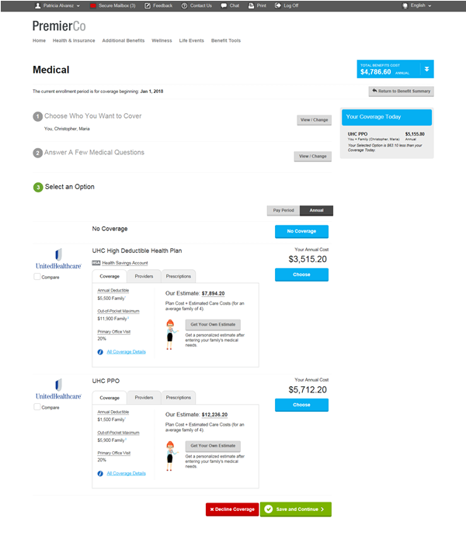
Medical Election Screen
Employee can use their choice of decision support tools ranging from plan design comparison charts, to a tool that helps them estimate total plan cost (payroll deductions + out of pocket costs) by answering a few questions.
Once an election is made here, they are taken to the HSA election page (if necessary) and the Tier 1 elective benefits (CI and Accident or HI).

Slide 22
LET’S TALK PROSPECTS

Slide 23
Recent MMX/VBES Deal (New Logo) – Biola
Biola Case Study: Sold Case, Enrollment Café, 6/1/18 Target Go Live
New Logo H&B and MMX Win – Steve Carleton worked with producer, AE and local sales lead to develop opportunity, proposal and deliver at finalist meeting
Sold on integrated value prop – robust technology was the more immediate need for Biola – moving from a paper environment to MMX ben admin
H&B broking levers will be evaluated and pulled in next plan year
Steve/AE introduced idea of Enrollment Café to Biola after discussing with Marc Lower
Unum previously approached Biola about in person counselors, so not a new concept. They gravitated towards our model and how it could pay for itself if the “right” VB mix was introduced.
Marc Lower took over as 2nd Chair – worked with Unum on plan designs, pricing and strategy, along with meeting with Biola in person to officially close the Café deal.
Biola gets Best of Both Worlds – alleviate administrative burden on their HR team and drive better HC decisions at OE with Café, Self Service and MMX/CBA call center
Revenue Projections: $60,000 to $70,000+
VBES: no expense for technology or call center
Products: Year 1 CI, ACC, ID Theft; Year 2 Permanent Life; Year 3 HI

Slide 24
Recent MMX/VBES Deals: Sample Case Studies
Fannie May Candy Company (Ferrero, Inc.) - EAST
Sale via Jim Hitchcock (AE from NJ). “Live” fall 2017.
Immediate need was for ben admin for 600 life acquisition out of Chicago, Fannie May Candy Company.
Creative use of Enrollment Café (low ratio of counselors to computers) to assist with AE. Scott DiGerolamo VBES lead.
Strong financial results ($100K+ in revenue), happy client, overall good experience. CI, ACC added.
Ferrero will likely add 1,000+ lives in 2018 (as parent company, and a new acquisition, add MMX & VBES)
PHI, Inc - SOUTHWEST
Sale was via Jay Robinson, Ed Lewis, Dana Scott (Houston and Austin offices). New Logo. Mark Murdock VBES lead.
2,200+ life group (helicopter provision/supply co.)
Sale was mid-2017, but MMX admin delayed to 2018
Modeled SS Offering 12/09 (Y1 Rev = $171,383; $77.90 Revenue Per Benefit Eligible).
Modeled: CI, ACC in Year 1, HI in Year 2. Decision soon.
MMX Team is Working with VBES Sales Lead on EVERY Opportunity
Notes:
. Mark

Slide 25
WRAP UP & CLOSE

Slide 26
Reminder: Standard MMX VBES Offering for 2018
ACTIVE Enrollment all 3 Years of the Contract
Recommended Strategy: CI & Accident in Year 1; HI Year or Perm. Life in Year 2, etc.
2 + 1 + 1 + 1
Adopting VBES
Best Practices
(Sequencing, Stacked Policies, etc.)
Call Center is MMX/Alight (for now); Main Options are Custom Comms. And Enrollment Cafe
Notes:
MMX is Aon’s LEAD Solution for Prospects with 500 to 5,000 Lives: No Exceptions!
MMX Drives Maximum Financial Advantage for Aon H&B Teams
Better Recovery/Retention than any 3rd Party Admin Solution
Alight is our delivery partner/subcontractor; not a lead option for 500 -5,000 lives
Approx.10% to 30% of MMX Revenue Comes Back to H&B Team as “Lift”
MMX ALWAYS includes a VBES Option: Drives Additional Revenue and Client Advantage
Either Self Service VBES Option; or
Full-Service Option (Counselors, Enrollment Café, Specialized Call Center, etc.)
Generates Additional Revenue and Lift for Each Client
MMX is a Bundled Solution : Consulting + Admin: We drive improvement across 3 key areas:
Engages Employees (MMX Platform, Upoint in 2018, Call Center/Advocacy)
Maximizes Cost Savings (CDHP migration, eligibility management, etc.)
“Takes work off of HR’s plate” (data management, employee questions, etc.)
MMX Fees are More Flexible/Competitive: recent offers have been at/below key competitors
Ben Admin pricing is often a “shell game”. Hard to understand “gross to net”
MMX is now more creative with pricing (using Carrier Leverage, Voluntary Benefit Offsets, etc.) to Reduce Set Up and Ongoing Fees.
Recent Example: Set Up Fees (from $45K to $0 after carrier credits); Ongoing Fees (from $6.25 to $4.50 after Self-Service Voluntary Strategy/Offsets)

Slide 27
Why MMX + VBES: “The 3 R’s”, Key Benefits to Aon!
Revenue
+
Recoverability
+
Retention
All MMX Revenue is H&B Recurring* Revenue to the local Market
Average 2017 New Logo Deal Size = $330k; adding VBES would = $450K!
Provide Revenue “Lift” to local office with margin built into MMX pricing
Voluntary Benefits upside is HUGE!
Additional revenue stream on H&B clients
Incremental Revenue from Administration and Voluntary Benefits helps improve client recoverability and rollover (new products added to keep growing)
Admin is “STICKY”
MMX deals are 3 Years (client retention is 95%+)
If WE are not talking to our clients about Admin or Enrollment, our competitors are
MMX reduces the risk of losing BORs or large portions of Voluntary Benefits commission dollars
Competitive Differentiator with bundled approach
Notes:
MMX Value for Clients
More Comprehensive Strategy – one partner for design through delivery
MMX Solves Issues involving:
Administrative Burden on your HR staff
ACA Compliance Concerns
Employee Education & Engagement; and
Controlling Benefit Costs
Pricing: MMX fees are becoming more flexible and competitive all the time
Aon Consulting + MMX is less expensive than Aon + Alight
Aon Leverage drives better rates for plan coverages and better MMX admin rates too
Various Carrier Credits that can be negotiated (to cover benefits administration fees - implementation, ongoing and/or change orders)
Set Up Fee Example: recent bid went from $50K gross to $0 net fee after Carrier Credits
Ongoing Fee Example: :used Voluntary Benefits to reduce PEPM from $6.25 down to $4.50

Slide 28
Thank You! For MMX assistance, email: Michael.Richerson1@aon.com Steven.Carleton@aonhewitt.com Andrew.Mazuro@aon.com Tyler.Benware@aon.com

Slide 29
Why MMX: Benefit to Clients
More Comprehensive Strategy
Competitive Pricing & Market Leverage
+
+
Solve More Client Challenges
+
Simplification
Benefits Strategy Delivered through Technology
Removed Silos
Consulting that supports automation and strong management of eligibility rules
More Comprehensive Data to Drive Informed Health Care Strategies
One Primary Contact
Fully Outsourced Admin Model to Take Significant Work Off the Plate of HR
Consistent Communication to all Employees
Benefits Cost Reduction
Enhanced Enrollment Experience Driving Stronger Employee Engagement
Alleviate Administrative Burden
More Robust Compliance Management
Vehicle to Offer More Choice and Educate Employees on Health Care Choices
Technology is Market Competitive
Voluntary Benefits will Offset Costs with MMX Simplified Offer (Best Practices Implemented)
Leverage with Insurance Carriers with Credits to Cover Implementation Costs, Ongoing or Change Order Fees
Notes:
MMX Value for Clients
More Comprehensive Strategy – one partner for design through delivery
MMX Solves Issues involving:
Administrative Burden on your HR staff
ACA Compliance Concerns
Employee Education & Engagement; and
Controlling Benefit Costs
Pricing: MMX fees are becoming more flexible and competitive all the time
Aon Consulting + MMX is less expensive than Aon + Alight
Aon Leverage drives better rates for plan coverages and better MMX admin rates too
Various Carrier Credits that can be negotiated (to cover benefits administration fees - implementation, ongoing and/or change orders)
Set Up Fee Example: recent bid went from $50K gross to $0 net fee after Carrier Credits
Ongoing Fee Example: :used Voluntary Benefits to reduce PEPM from $6.25 down to $4.50

Slide 30
Appendix: MARKETING MATERIALS Sell Sheets, EBN White Paper, Videos, etc. (many updates for 2018 are in process)

Slide 31

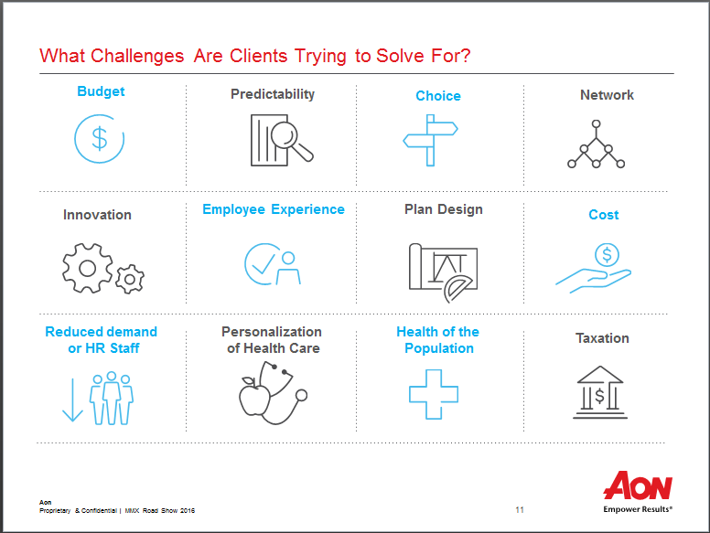
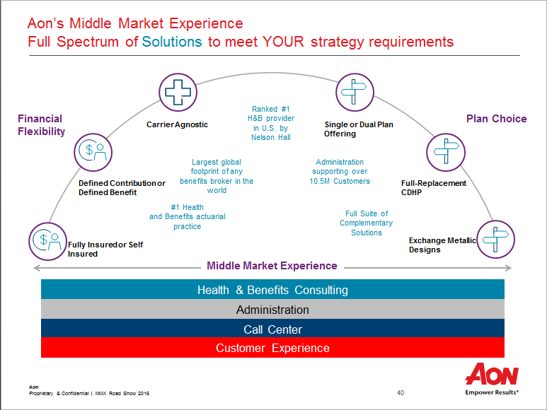
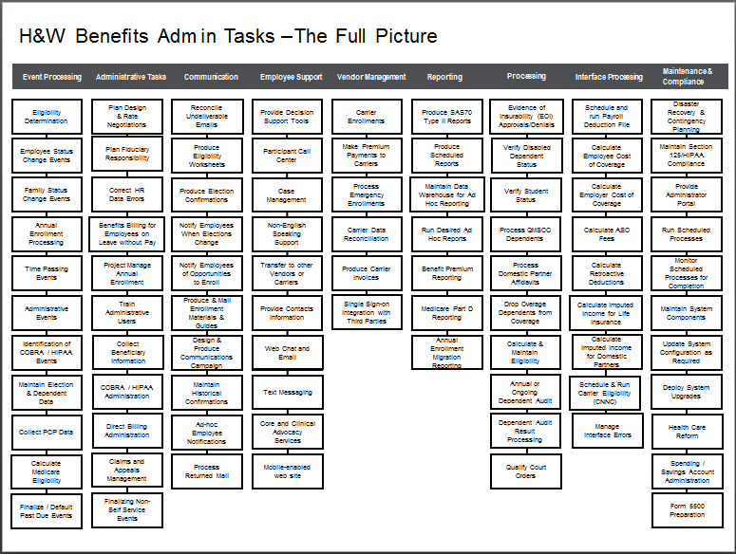
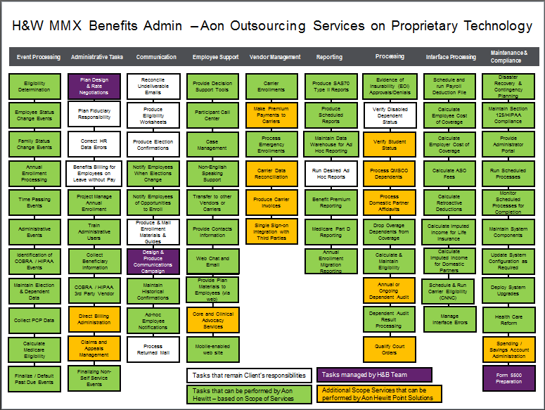
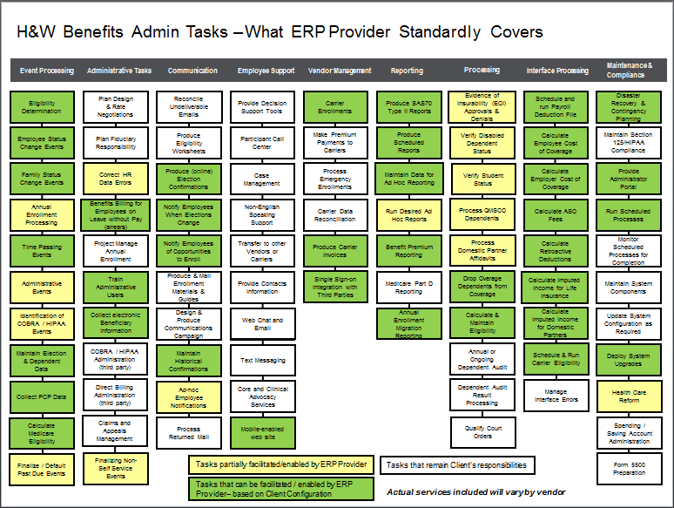
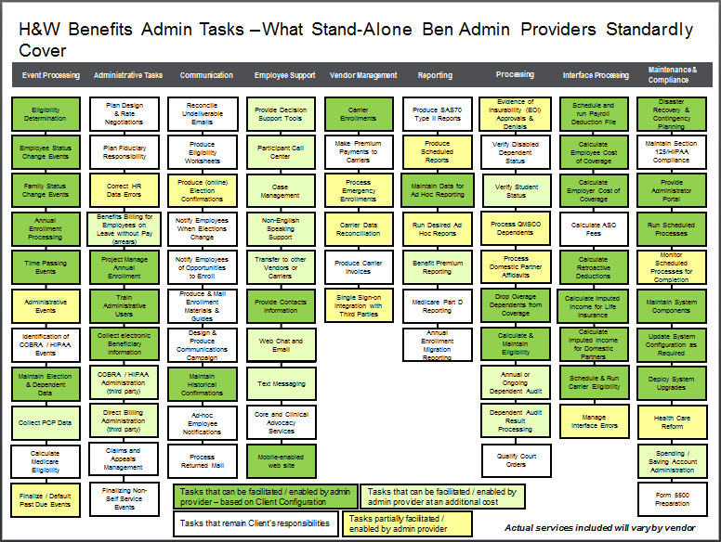
Updated MMX Slide Deck(s)

Slide 32
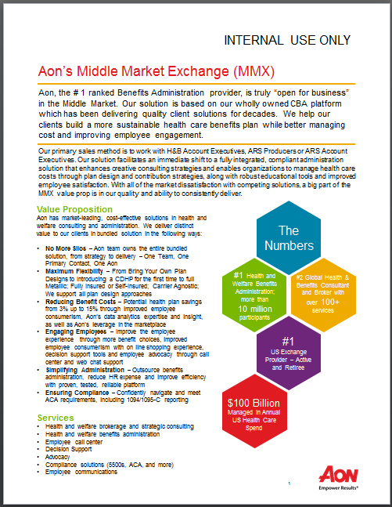
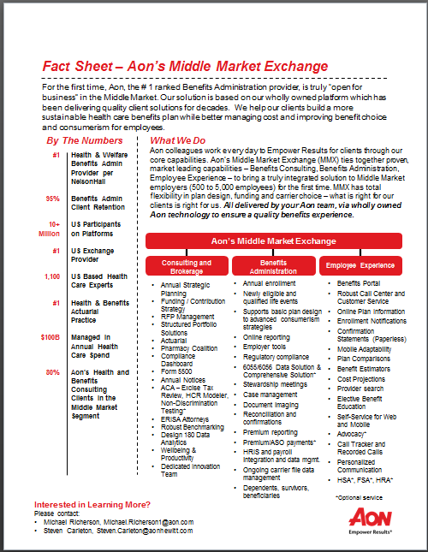
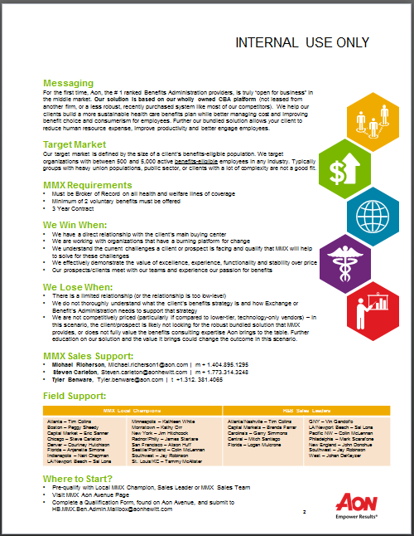
MMX Sell Sheets & Marketing Content

Slide 33
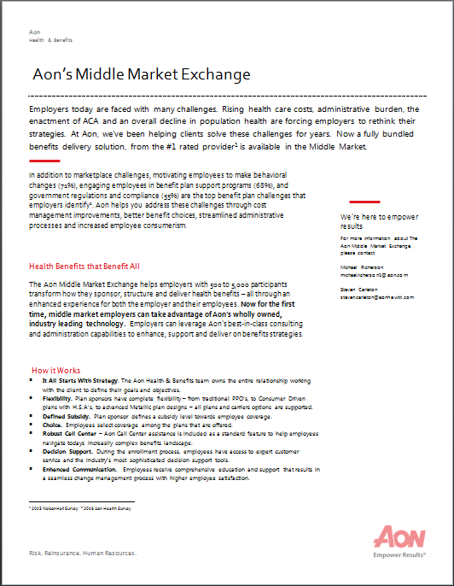
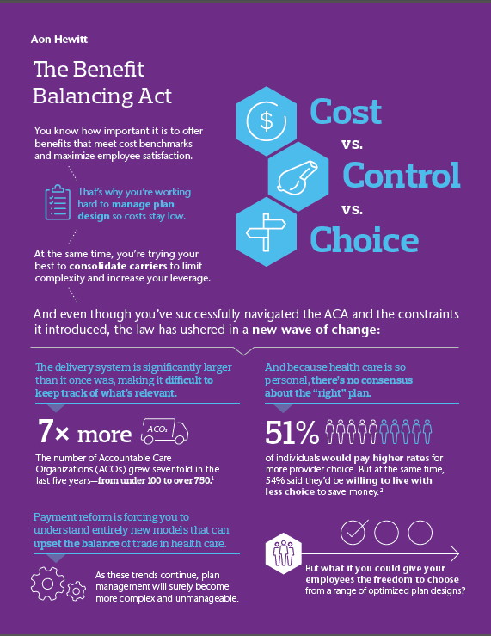
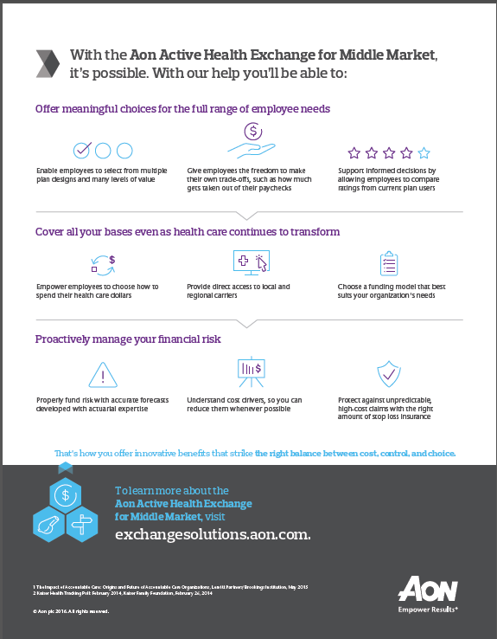
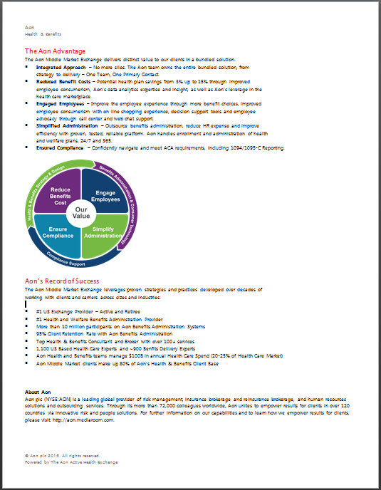

MMX Sell Sheets & Marketing Content

Slide 34

Aon Middle Market Solution Summary
Enrollment & Events
Annual enrollment
New Hire enrollments
Qualified Life Events
“Aging Out” events (retirements, age 26 dependents, etc.)
Employer Support
Online reporting
Employer tools
Regulatory research
Stewardship meetings
Case management
Document imaging
Eligibility
Dependent management
Reconciliation & confirmations
Premium reporting
EOI Approvals
Bi-Lingual Call Center
9am to 7pm EST
Full Spanish Support
Telephonic Enrollment
Employee Advocacy*
Data Transfer & Management
HRIS & payroll integration
Ongoing carrier interface management
Dependents, survivors, beneficiaries
Communications & Decision Support
Benefits portal
Online plan information
Plan cost comparisons
Enrollment notifications
Provider Search
Text Message Notices (2017)
Compliance
Form 5500
Compliance Dashboard
The Washington Report
ACA Reporting, includes
1094/1095-C (but printing
and fulfillment is optional)
Optional Services
Wellness Solutions*
Employee Advocacy*
QMCSO Qualification*
Full Dependent Verification Services*
Premium Reconciliation & Carrier Payment Services*
1094/1095-C Printing, Mailing & Fulfillment Services*
Consulting/Broking
Annual Planning
RFP Management
Health Plan discount analysis
Provider discount analysis
Strategic Savings Calculator
Funding/Contribution Strategy
Note: 2 lines of voluntary benefits is required
Benchmark &
Analytics
Aon Bench
Greater Insight
AH Health Value Initiative*
Benefit Index*
Experience Monitoring Report
*Optional services
Notes:
This slide represents a more detailed view of the services included in our HW benefits administration solution.
Enrollment -Aon Hewitt supports not only annual enrollment but also new hires and other forms of newly eligible employees, life and retirement events. We support all HIPAA qualifying life events, such as birth/adoption, the loss or gain of other coverage, or qualified medical child support order, as well as other events that may impact eligibility such as a job transfer. We also offer a COBRA and direction billing and payments service.
Eligibility – Our system is designed to simply and automate the eligibility process and display only those benefits for which your employees are eligible. During implementation, Our team carefully documents your eligibility rules so your employees see only those benefits for which they are eligible. To ensure that your employees are compliant with your eligibility rules and provide the proper documentation for dependents and life events, we offer an optional dependent verification and audit service. Our services also include premium reporting and payments.
Messaging and Communications - Our communications programs helps your employees make benefits choices using a mix of email, Web‑based, and even print materials if needed. Our communications start with the employee website where employees can learn about, enroll and manage their benefits year‑round. The site displays up to two years of benefit information, detailed summary plan descriptions and more. Our solution also includes emails and other electronic communications that include enrollment reminders and benefit “teasers.” We also automatically send a variety of messages including: open enrollment announcements and reminders, and worksheets as well as confirmation statements.
Decision Support – As the employee proceeds through enrollment, we provide a host of decision support tools such as the plan comparisons, cost projection tools such as a medical expense estimator, and provider search . Other tools include a health spending account calculator, a life insurance estimator, a dependent care spending account estimator and more.
Wellness and productivity - we also provide you tools and resources to help promote wellness and productivity. For example, your employee website can be customized with an employee wellness center that features detailed information about your wellness program. We can also provide you with an optional advocacy program where we help your employees resolve claims challenges with insurance providers. We also offer optional absence management solutions to reduce costs and productivity issues associated with absenteeism.
Customer Service – If your employees need help, our Customer Service Center features trained representatives who are available via a toll‑free phone number, email, online chat, fax and mail. Our reps helps employees who are having difficulty navigating through the online enrollment process or who may need assistance in logging into the website. Our Service Center will answer benefit related questions and provide support for employees with qualified life events, and other employment events such as new hires that allow the employee to make benefit changes throughout the year.
employer Support –We place a great deal of emphasis on not just the employee experience but also on providing employer support. This includes not only online reports but also very powerful online tools that provide complete visibility into employee data and transactions. In addition to tools, we provide an ongoing delivery team of benefits technology experts who will serve your organization and employees post‑enrollment. They’ll not only not track any system issues that may arise but also coordinate regular stewardship meetings as well as keep you informed of updates on the latest regulations so that your system stays current and in compliance.
Data Transfer - As the world’s leading benefits outsourcing provider, Aon Hewitt knows how to maximize your company’s health and welfare program. We do this by designing and delivering health benefit plans that increase productivity and wellness yet reduce administrative costs, improve efficiencies and focus intently on customer satisfaction.
Additional Services- As the world’s leading benefits outsourcing provider, Aon Hewitt knows how to maximize your company’s health and welfare program. We do this by designing and delivering health benefit plans that increase productivity and wellness yet reduce administrative costs, improve efficiencies and focus intently on customer satisfaction. This slides lists several of our most common additional services for our health and welfare clients.

